Slide 1
BULK PAYMENT
DESIGN

Slide 2
LOGICAL ARCHITECTURE
Back Office Users
Client Users
Create Other Users
Create Clients
Create Other Users
Initiate Payments
Approve Payments
BO Username
BO Password(Default)
Role
Name
MSISDN
Admin Username
Admin Password(Default)
Role
CL Username
CL Password(Default)
Role
Manual
File Upload
Send for Approval
Approve
Reject

Slide 3
Permissions
Module | Permissions
BO User Management | BackOffice.manageUser BackOffice.viewUsers
BO Client Management | BackOffice.manageClient BackOffice.viewClients
CL Admin | Clients.manageClient Clients.manageUsers
CL Payments | Payments.initiatePayment Payments.approvePayments Payments.reports Payments.statement

Slide 4
MENU STRUCTURE
Menu | Permissions
Home | Anonymous
Login | Anonymous
Clients | BackOffice.manageClient BackOffice.viewClients
Client | Clients.manageClient Clients.manageUsers
Payments | Payments.initiatePayment Payments.approvePayments Payments.viewPayments Payments.reports Payments.statement

Slide 5
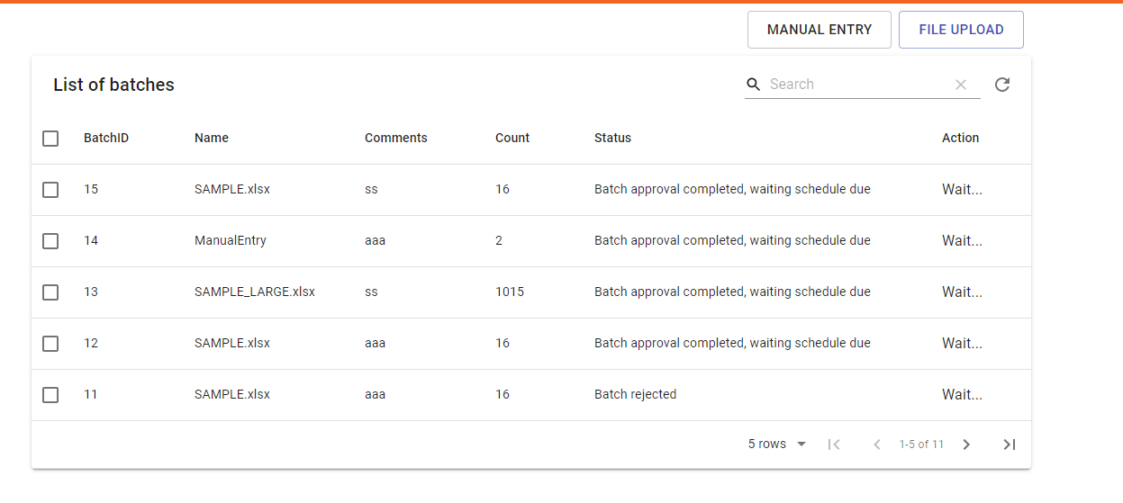
BULK PAY
Home
Login

